Slide 1
How do the unique environmental factors present in Stellwagen Bank affect humpback whales
By: Sean Folan

Slide 2
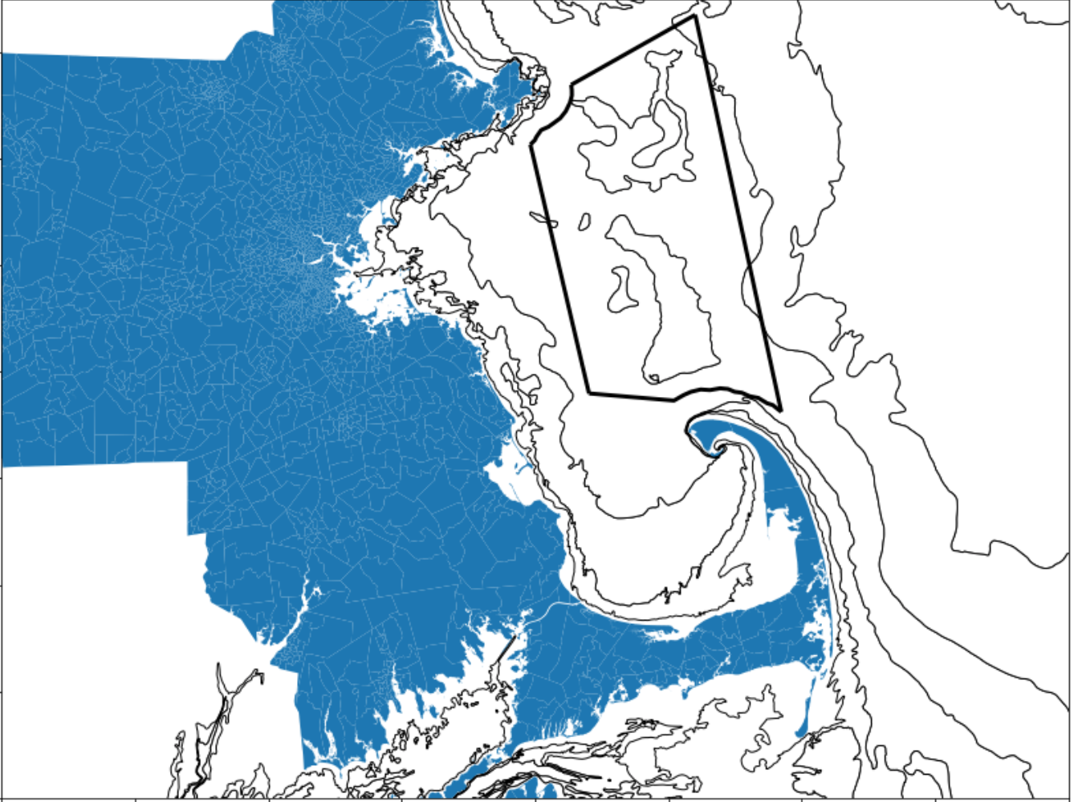
Introduction to Stellwagen Bank
Stellwagen Bank is one of only 13 National Marine Sanctuaries in the US
It is located East of Boston off the coast of Massachusetts
It is a popular destination for whale watching
Stellwagen Bank National Marine Sanctuary

Slide 3
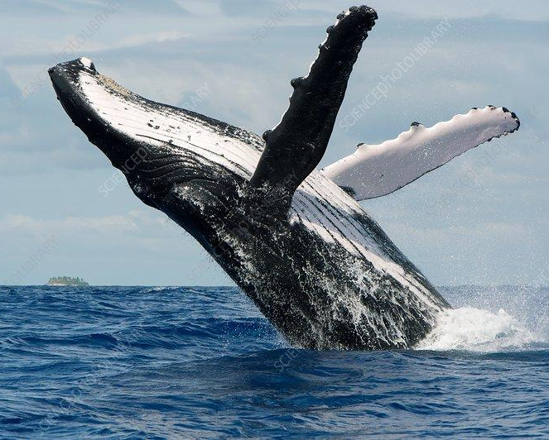
Purpose of Whale Watching
Whale Watching is one of the largest ecotourism industries in New England
These whale watches also serve the purpose of data collection
The humpback population in New England is the longest studied population of humpbacks in the world

Slide 4
Data Collection
Naturalists from the New England Aquarium collect a wide array of data in collaboration with the Center for Coastal Studies
Data is collected about environmental conditions such as Weather and Sea Height as well as data about each sighting including species and behavior
All of this data collection over more than 4 decades has resulted in a very large and detailed database which can even be used to create family trees for whales
The data I used included 33,302 sightings from 2013-2019
Source: Boston Harbor City Cruises

Slide 5
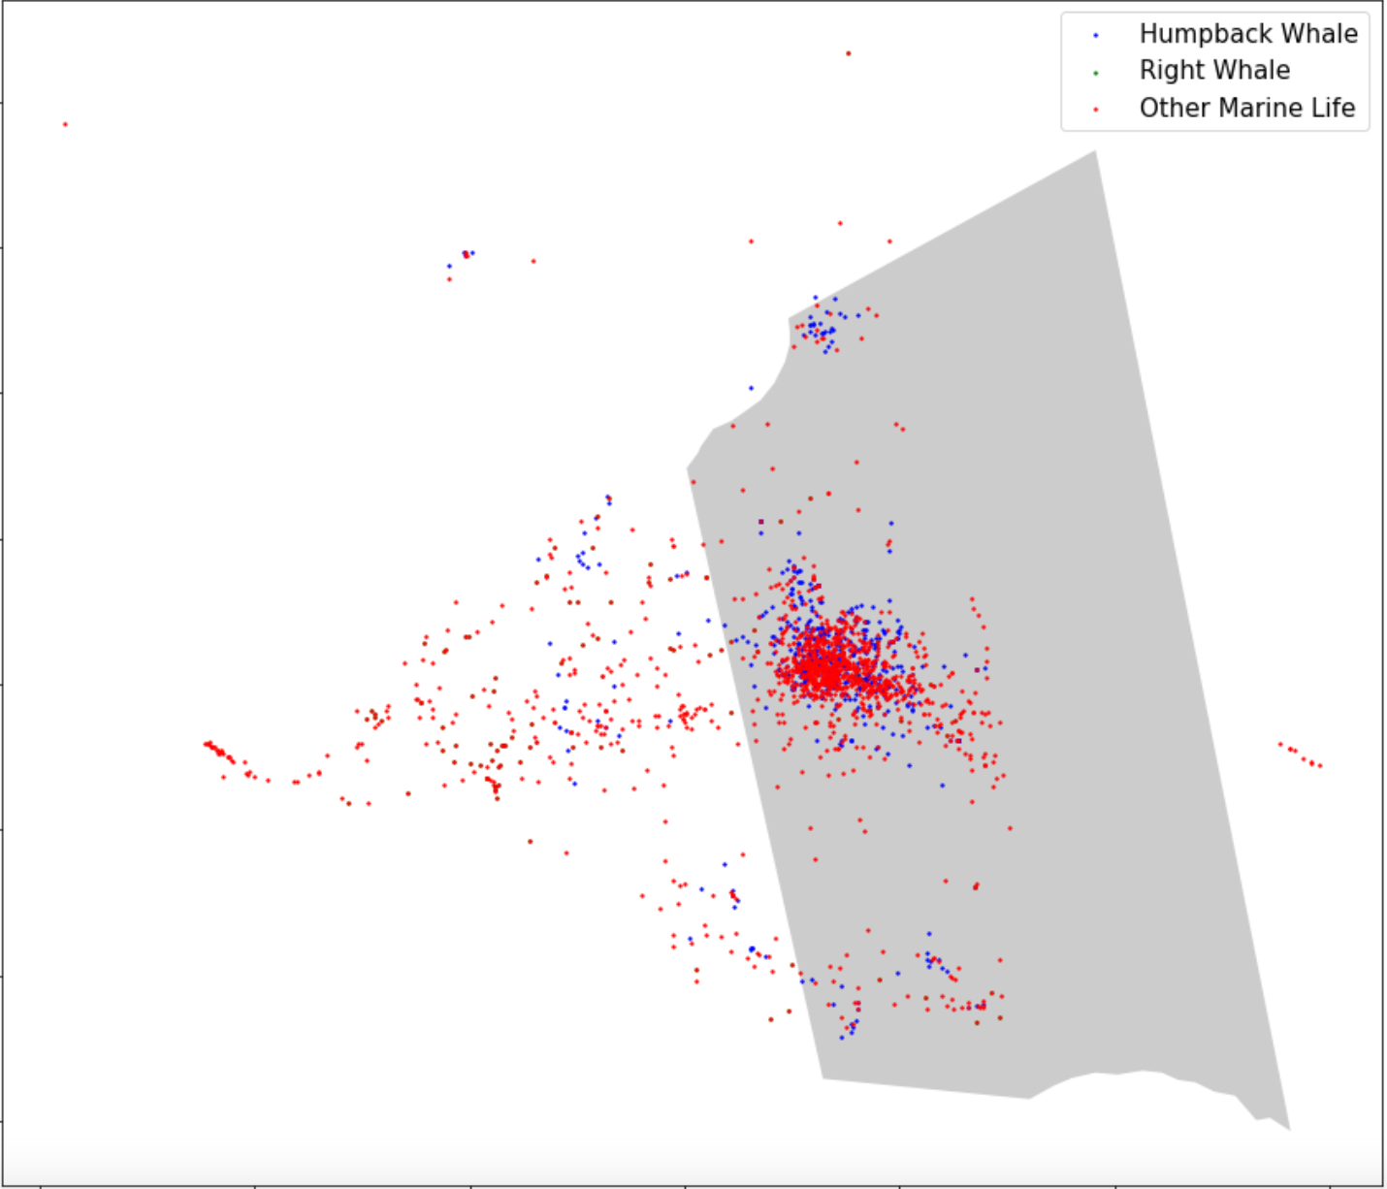
Initial Data Analysis
My first step with the data was to visualize the data
Most of the plotting was done using the geopandas and matplotlib.pyplot libraries in python
However, this plot does not convey much if you aren’t familiar with the bank

Slide 6
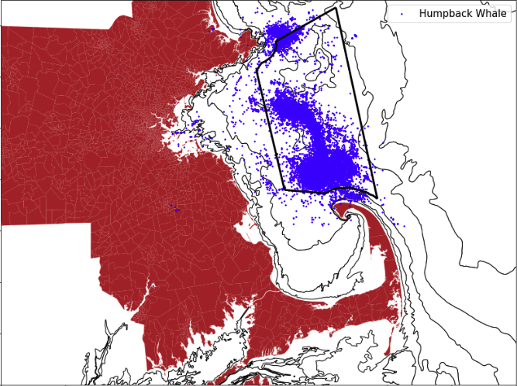
More Data Analysis
For my second plot, I included more detail
I removed the clutter of the sightings that were not humpbacks
Then I also added in nearby land and the bathymetry of the Gulf of Maine

Slide 7
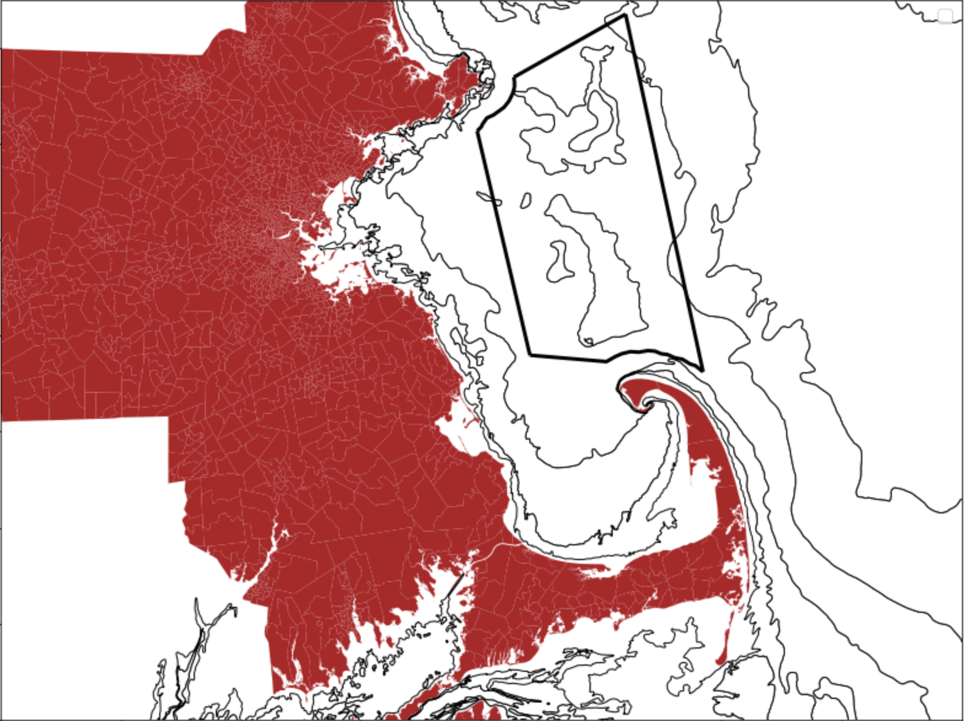
One of the first interesting things that thes plot show is that these whale actually congregate on the underwater plateaus. They do this since the drop off provides the perfect conditions for upwelling which brings nutrients which are usually in the deeper water closer to the surface.

Slide 8
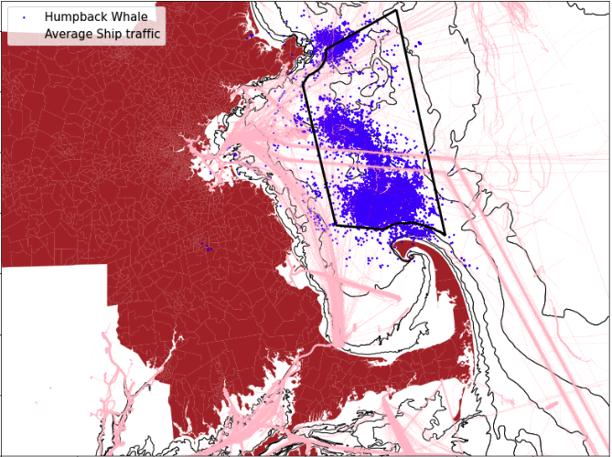
Ship Traffic in Stellwagen Bank
Just because Stellwagen is a Marine Sanctuary doesn’t mean it is completely devoid of human activity
There is even a major shipping lane that goes straight through the Sanctuary which was moved in 2007 to protect Right Whales

Slide 9

Sci-Kit Learn
Even though I was able to notice some interesting patterns through plotting and looking at the data, I can not go through tens of thousands of sightings to fully answer my question.
Through utilizing machine learning I can train a model to do the work for me while looking at all of the pieces of data.
I chose to use the library Sci-Kit learn due to its versatility and its preprocessing tools which I used to convert my original data into a form that could be used in a model

Slide 10
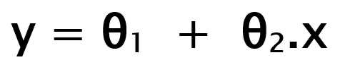
Linear Regression
For my model, I used the Linear Regression feature to see if the computer could predict the latitude of the whale sightings given 10 of the environmental factors
Linear Regression is based on supervised learning
It attempts to predict the dependent variable (y) by coming up with a linear regression of y in relation to the independent variable (x)

Slide 11
X (Independent Variables) | Y (Dependent Variable)
Current Weather | Latitude of the Whale Sighting
The Weather During the Past 12 hours
Visibility in Nautical Miles
Cloud Cover
Wind Direction
Wind Speed
Swell Direction
Swell Height
Sea Height
Hour of Departure

Slide 12
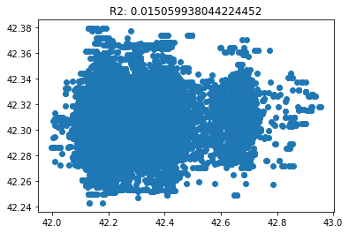
Model Results
The model resulted in the graph to the right
On the y-axis is the predicted latitude and the x-axis is the actual latitude
The R² of this graph is .015 which means there is no correlation or a very weak correlation

Slide 13
Conclusion
Even though the model showed that the environmental factors alone are not enough to predict the location of a whale in Stellwagen Bank, I am very satisfied with my findings
Before this summer I had never worked with python or machine learning and I feel I have developed a solid understanding in both
I plan to continue this project to try and predict what section of the bank the whales are in as well as what behaviors whale watchers are likely to see.
Along with this I plan to answer my original question about the pandemic’s affect on humpback whales as soon as the data for 2020 and 2021 becomes available

Slide 14
Thank you
I wanted to thank all the people who helped me with this project
Special thanks to
Christof Teuscher as well as the rest of the altREU staff
Martin Siderius for helping me as a mentor all summer
Laura Howes and the New England Aquarium for helping me with access to the whale sighting database
Sources
https://oceanservice.noaa.gov/ocean/sanctuaries/
https://coastalstudies.org/humpback-whale-research/
https://www.mass.gov/info-details/massgis-data-layers
https://coast.noaa.gov/digitalcoast/data/vesseltraffic.html
https://www.geeksforgeeks.org/ml-linear-regression/
https://scikit-learn.org/stable/
https://www.neaq.org

Slide 15
Sources
https://oceanservice.noaa.gov/ocean/sanctuaries/
https://coastalstudies.org/humpback-whale-research/
https://www.mass.gov/info-details/massgis-data-layers
https://coast.noaa.gov/digitalcoast/data/vesseltraffic.html
https://www.geeksforgeeks.org/ml-linear-regression/
https://scikit-learn.org/stable/
https://www.neaq.org

